Slide 1
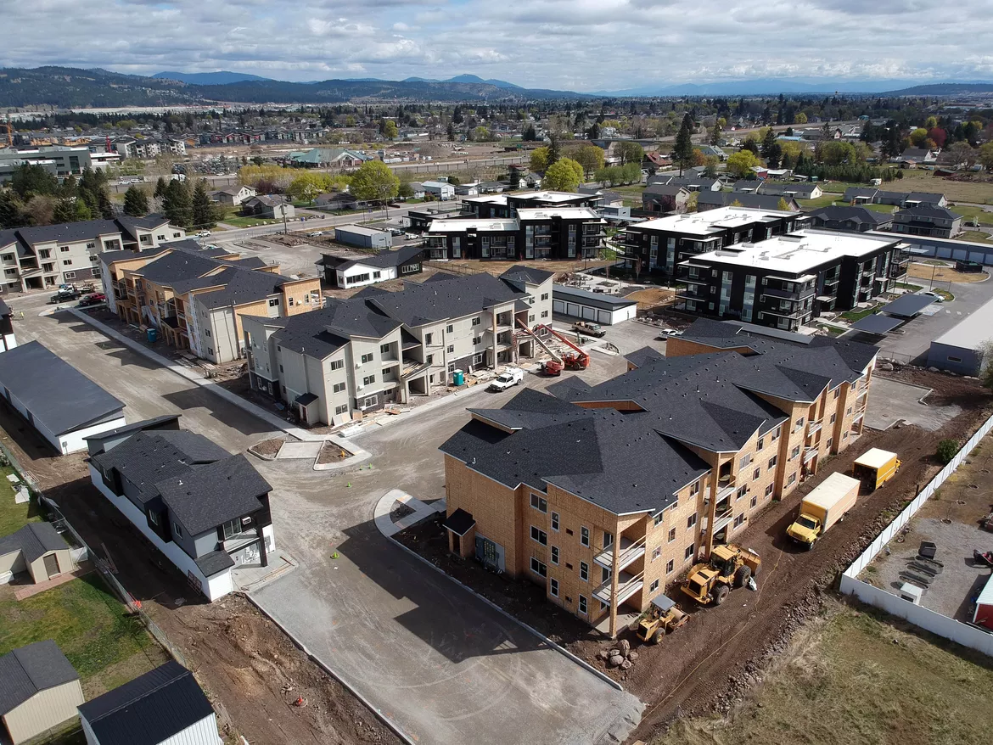
Spokane State of the Market

Slide 2
Spokane Association of REALTORS®
MLS Housing Data 2011-2022
208% Increase 2015-22
315,000
300,000
283,527
234,900
195,000
210,000
179,900
168,000
160,000
164,500
154,300
2011 2012 2013 2014 2015 2016 2017 2018 2019 2020 2021
January 2022 - $375,000

Slide 3
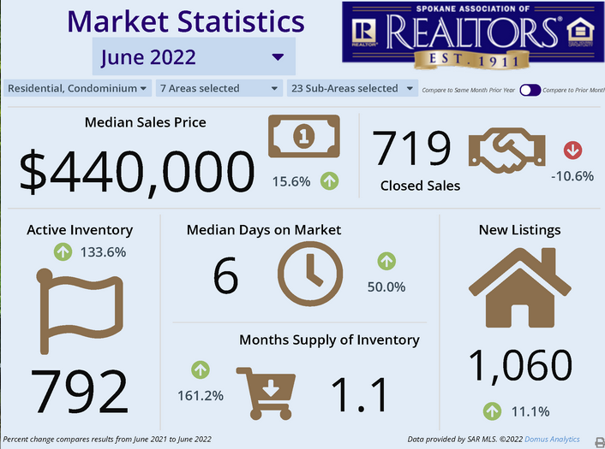
Spokane State of the City

Slide 4
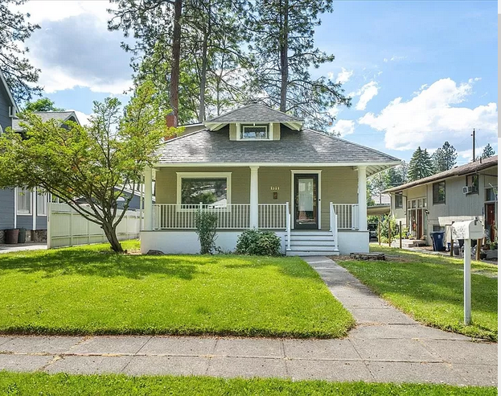
Shadle Park Rancher
2015 $179,900
2022 $440,000

Slide 5
Spokane Association of REALTORS®
MLS Housing Availability Data 2010-2022
2,348
67% Decrease
1,427
792
2010 2017 2022
Homes for Sale
Source: SAR Multiple Listing Service

Slide 6

Spokane State of the Market
5-10 offers for homes
Escalation of pricing 2% - 5% over asking
1 in 5 homes sold for cash
NAR – Spokane, one of two hot markets on the West Coast

Slide 7
Spokane Vacancy Rates
Spring 2022 - 1%

Slide 8
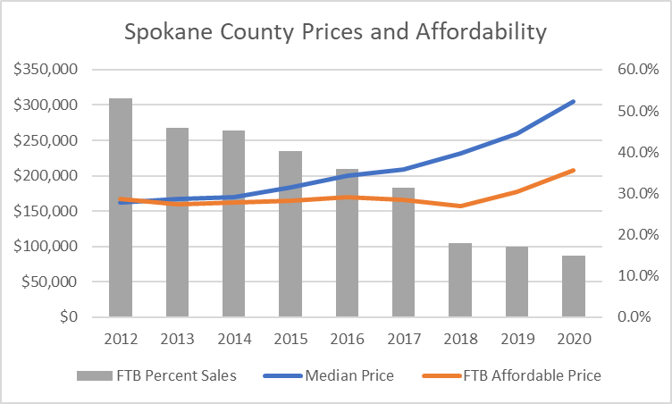
State of the Market
WCRER Report Fall 2022 – show that has fallen to 8%

Slide 9
Spokane Market Report
West Coast Median Home Prices
California – $760,800
Washington - $595,732
Oregon - $502,215
Utah - $544,868
Colorado - $559,838
King County - $828,111
Boise - $569,900
Vancouver, WA - $501,500

Slide 10
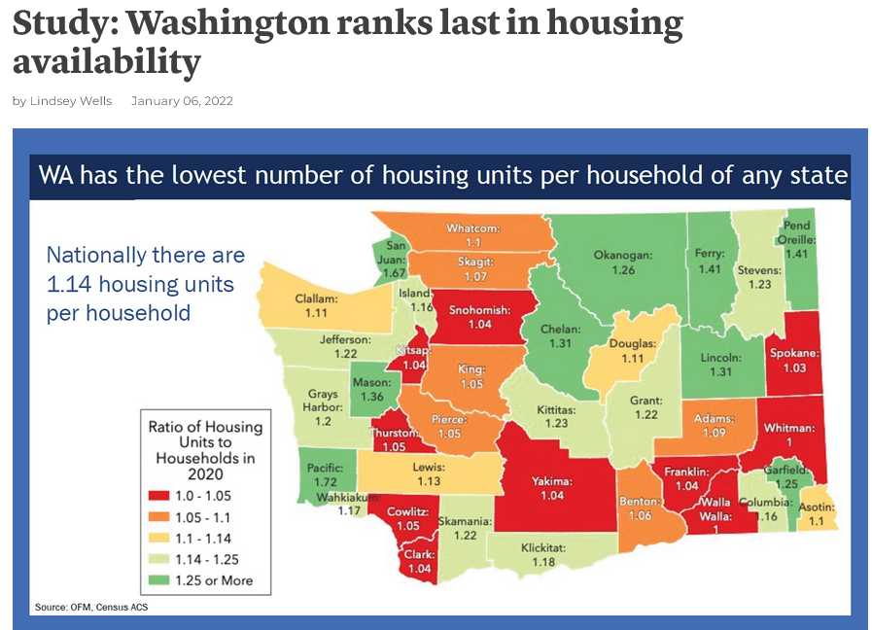

Slide 11
Spokane State of the Market
Housing rentals
What has caused our tight housing market?
Supply vs Demand
Census numbers for 2020
City of Spokane – 228,000 (100,000 families)
Spokane County – 539,000 (236,403 families)

Slide 12
Supply vs Demand
Census numbers for 2020
City of Spokane – 89,000 Housing Units
Spokane County – 227,000 Housing Units
Housing per family
US 1.14
Wash 1.09
Spokane .089*
Spokane County 1.03
*City of Spokane – 25,000 housing units short

Slide 13
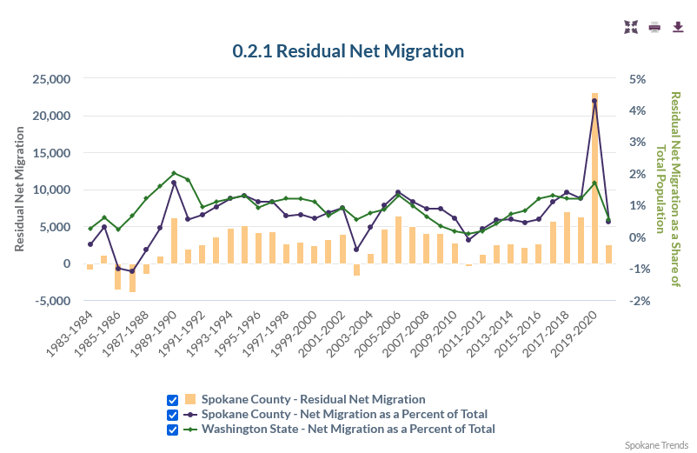
Spokane State of the Market
Residential Vacancy Rates – 1%

Slide 14
Loss of Residential Rental Inventory
Spokane landlords may be selling off existing
rental stock at an accelerating rate
Study of 2,000 units in the City of Spokane
Loss of 9% of rental stock in 2020
13% of all housing stock in 2021

Slide 15
Changing Family Dynamics
1 in 4 families now multigenerational
26% increase
Key reasons:
66% Economy
57% Driven by Pandemic
1 in 3 need for eldercare/age in place
1 in 3 need for childcare
7 of 10 families say they will continue

Slide 16

Counselors of Real Estate Report
1.Implement existing plans
2. Zoning changes that support diversity in housing type and lot sizes.
3. Increase the density allowance.
4. Decrease average lot sizes and modify transition rules.
5. Hire a Planning Director
6. Fill other vacant planning positions
7. Look at best practices in other cities and states
  • Chattanooga, TN – reinventing of downtown, including waterfront & housing
  • Madison, WI and Champaign, IL – controlling sprawl
  • Norfolk, VA – addressing the ‘Missing Middle’
  • Orlando, FL – regional coordination
  • Minneapolis, MN and Alexandria, VA – workforce/affordable housing solutions
8. Formalize the engagement process
9. Prioritize affordable housing near jobs
10 Provide Certainty
11. Incentivize the development of “the missing middle.”
12. Use “Carrot and Stick” approaches. The above examples are the ‘carrot.’
13. Work with government agencies on growth management
14. Make community engagement a priority on all levels.
15. Regional solutions

Slide 17
Housing Types

Slide 18
City of Spokane
Hired a new planning director
Maximum detached ADU size is 975 sf or 75% of house size
Removed minimum lot size to build an ADU.
Specific building coverage increase to 20% for detached ADUs on lots under 5,500 sf.
Permit an ADU on a site with any principal structure, such as a duplex or triplex, in RSF, RTF, RMF, and RHD zones.
The lot size transition requirement in SMC 17C.110.200 has been removed to encourage construction of more housing units.
SEPA Review modified notification for small subdivision
Preliminary and Final Short Plats Fee are reduced.

Slide 19
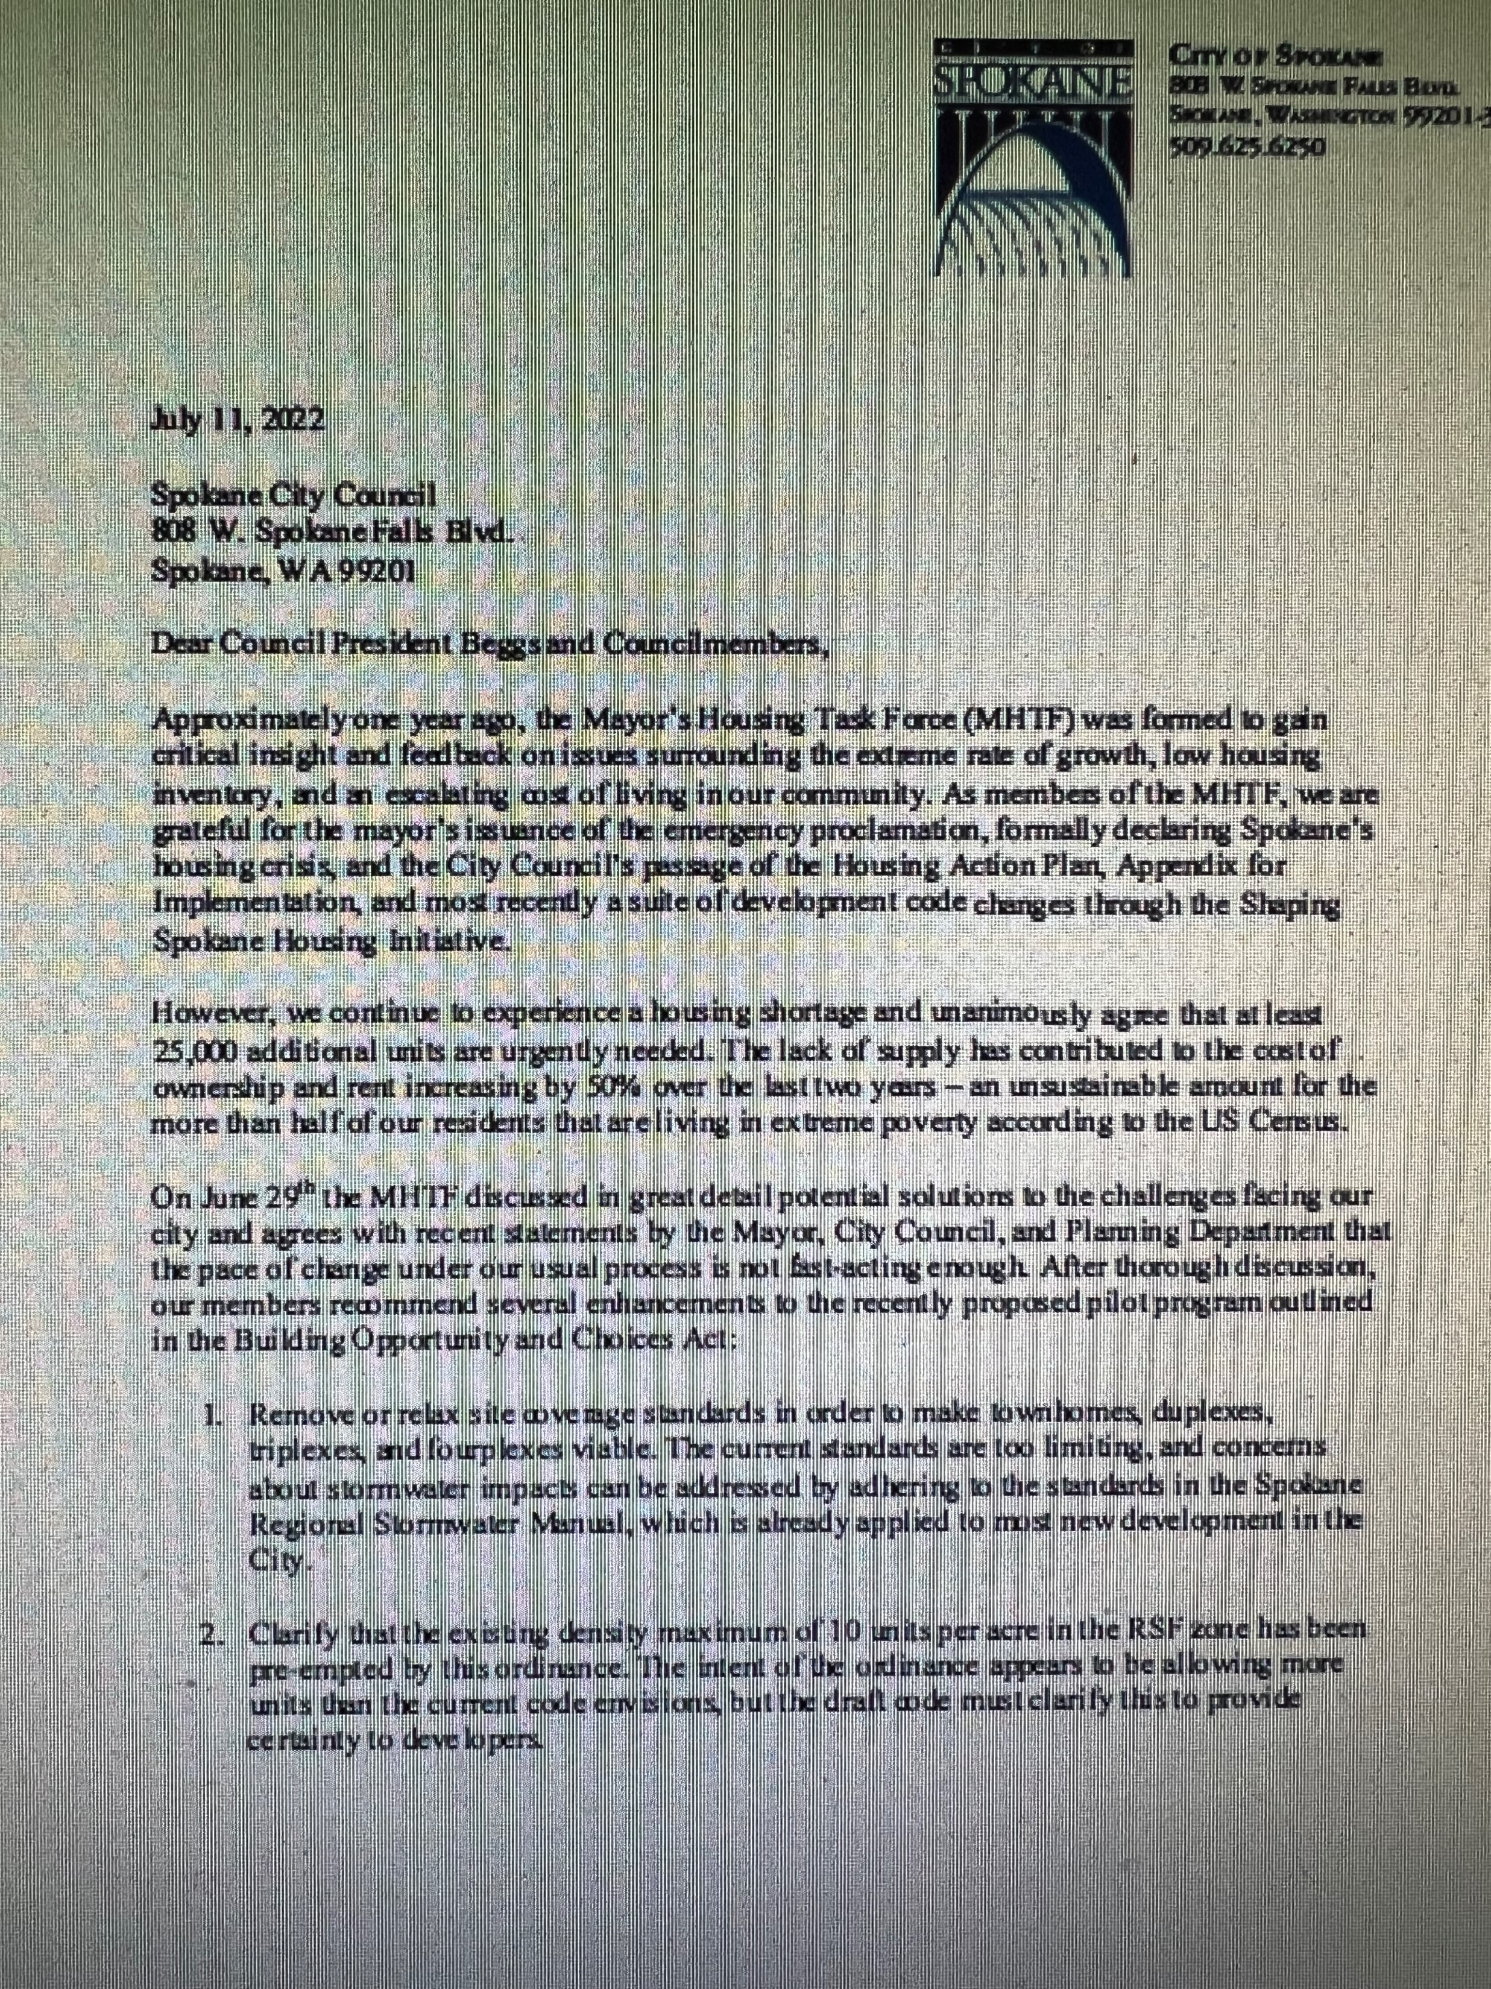

Mayor’s Housing Task Force
Vote Expected July 25, 2022

Slide 20

Mayor’s Housing Task Force
Remove or relax site coverage standards in order to make townhomes, duplexes, triplexes, and fourplexes viable.
Clarify that the existing density maximum of 10 units per acre in the RSF zone has been pre-empted by this ordinance.
Reconfigure the current standard in City code that requires all new development to have frontage on a public street.
Increase height limits, especially for townhomes to 40 feet
Remove floor area ratio (FAR) as a development constraint.
Increase height limits and reconfigure development standards in other zones beyond RSF.

Slide 21
Spokane State of the Market
What’s Next?
SAR Housing Summit – Fall 2022
Research Project with Spokane Assessor
Spokane County Commissioner Races
Mayor, Council Pres,
5(?) Council Members 2023

